Slide 1
What is Memory Latency (CL)
and how it affects to the perfomance of our computer
Franco Larrea 1º ASIR

Slide 2
What is it?
A RAM module’s CAS latency is how many clock cycles in it takes for the RAM module to access a specific set of data in one of its columns and make that data available on its output pins, starting from when a memory controller tells it to.
CAS = (Column Address Strobe or Signal)

Slide 3

How to calculate the frequency?
The market sells the transfer rate as if it were the frequency.
Current memories are DDR (DOUBLE data rate) type.
So the "frequency" (transfer rate) is divided by two to get the actual frequency.
= 2666Mhz / 2 = frequency

Slide 4
How to calculate the latency?
We need the real latency
Can calculate with a simple formula.
Is the next:
(1000 / real frequency) * CAS latency

Slide 5
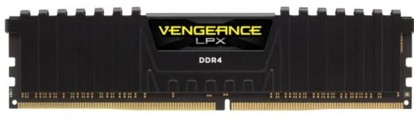
Example
2666MHz
CL16
Real frequency = 2666 / 2 = 1333MHz
Real latency = (1000 / 1333) * 16 = 12

Slide 6
How latency affects processor performance
The time it takes for the processor to access data in RAM is called memory access latency.
The less time it takes to do it, the better it will be for our computer performance.

Slide 7
Reference
What Is CAS Latency in RAM? CL Timings Explained
Qué es la latencia de la Memoria RAM y cuál es su importancia?
CAS latency

